Slide 1
Title Slide
Project Title: Movie Recommender System
Presented by: Vishal Gupta,Varun Arya,Shivam Nishad
Tools & Technologies: Python, Pandas, Scikit-Learn, StreamLit , PyCharm, Jupyter Notebook.
Data
Processing
Model
Convert in website
Deploy
PROJECT FLOW

Slide 2
Project Overview
Objective:
Build a recommendation system that suggests movies based on user input.
Workflow:
Data Preprocessing: Clean and prepare data using Pandas , NumPy
Feature Engineering: Compute movie similarity using cosine similarity.
Model Development: Recommend top 5 similar movies based on user input.
Web App: Deploy the model as an interactive web application using StreamLit in PyCharm.

Slide 3

Dataset Overview
Contains details of 5000 movies.
Key Attributes:
Movie ID
Title
Genres
Overview
Cast & Crew

Slide 4
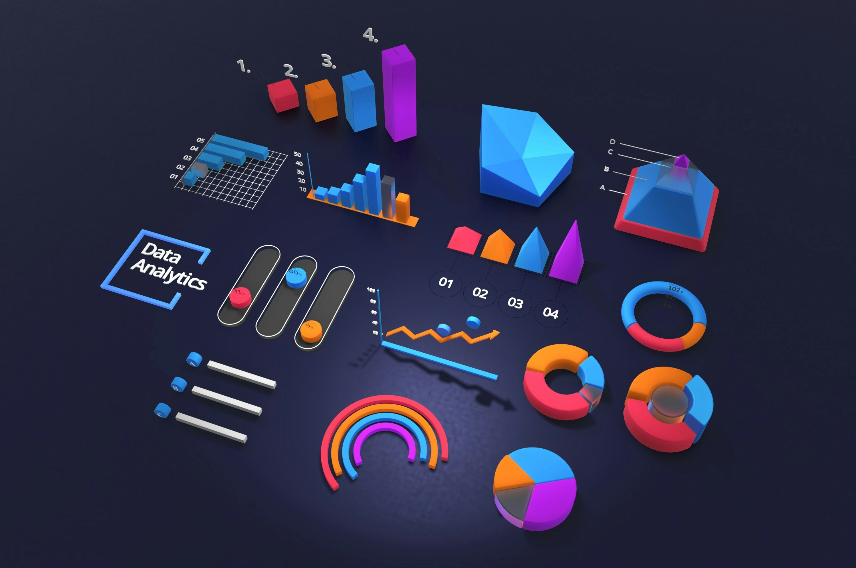
Data Preprocessing
Python Libraries Used:
Pandas: For data manipulation and cleaning.
Scikit-Learn: For model creation and similarity computation.
Steps :
Handle missing data.
Convert genres and cast to a structured format.
Compute feature vectors for similarity.

Slide 5

Model Development
Model Description:
Approach: Content-Based Filtering using cosine similarity.
Input: Movie ID selected by the user.
Output: List of recommended movies.

Slide 6
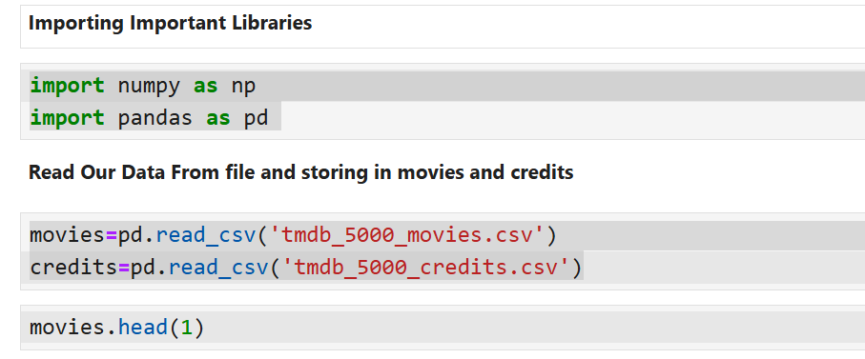
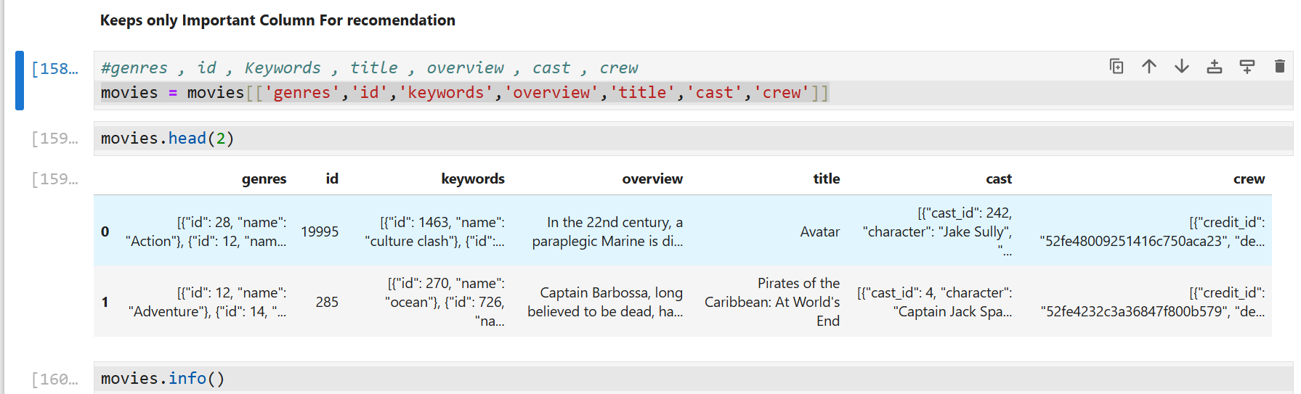
Python Code Snippet

Slide 7
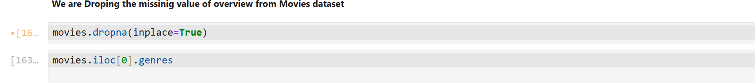
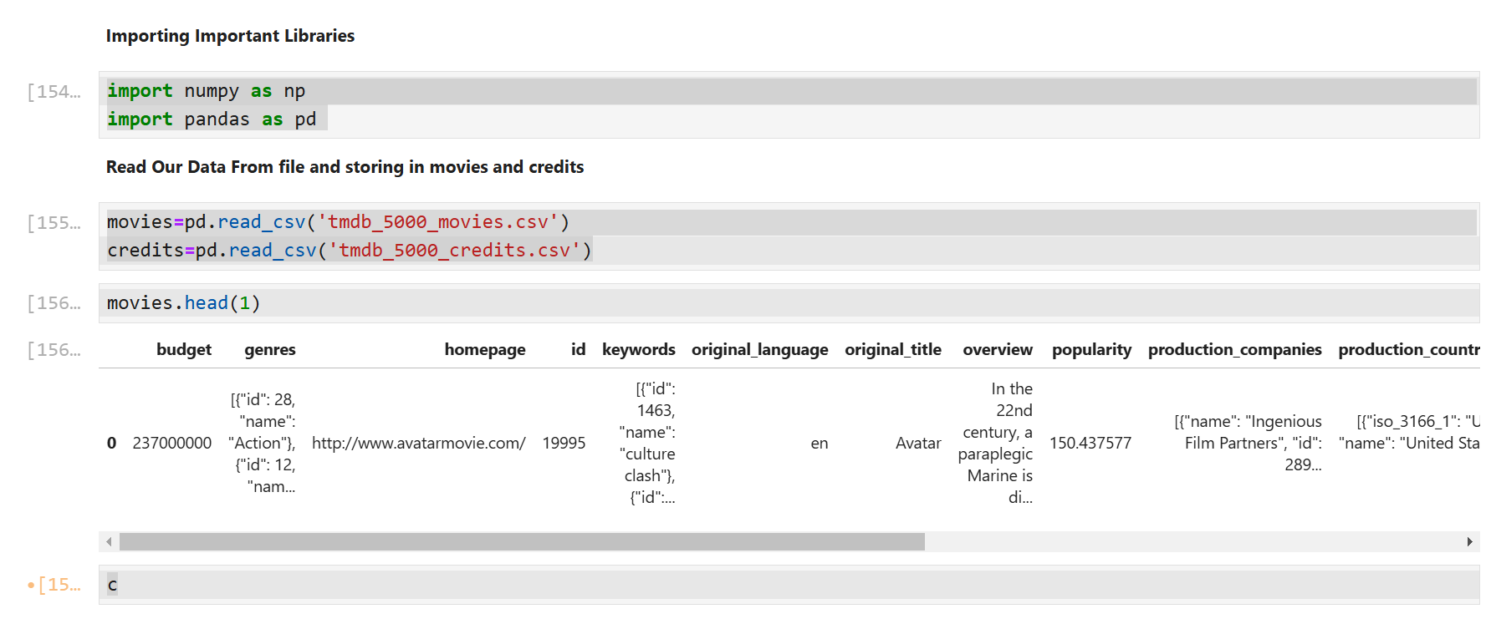
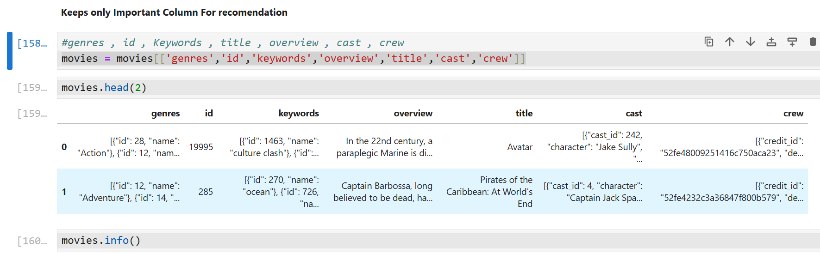

Slide 8
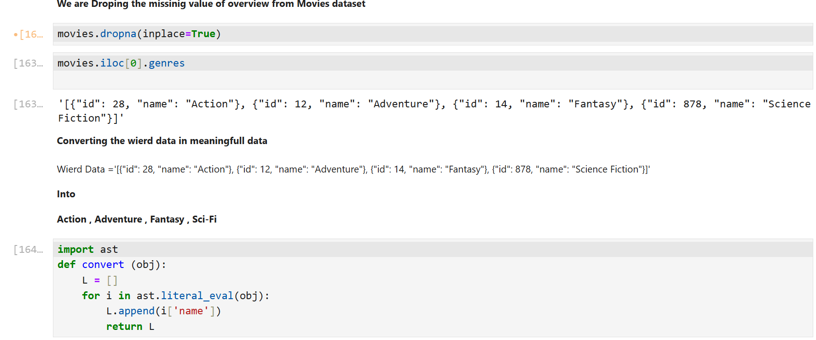
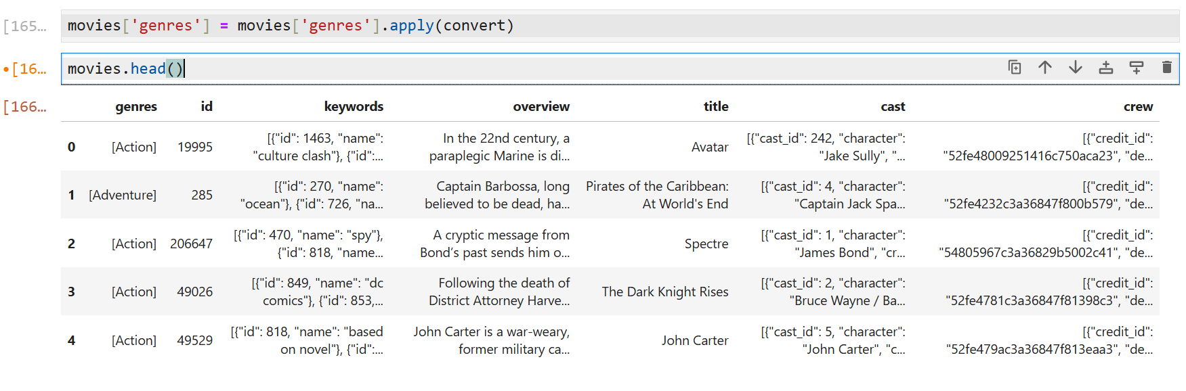

Slide 9
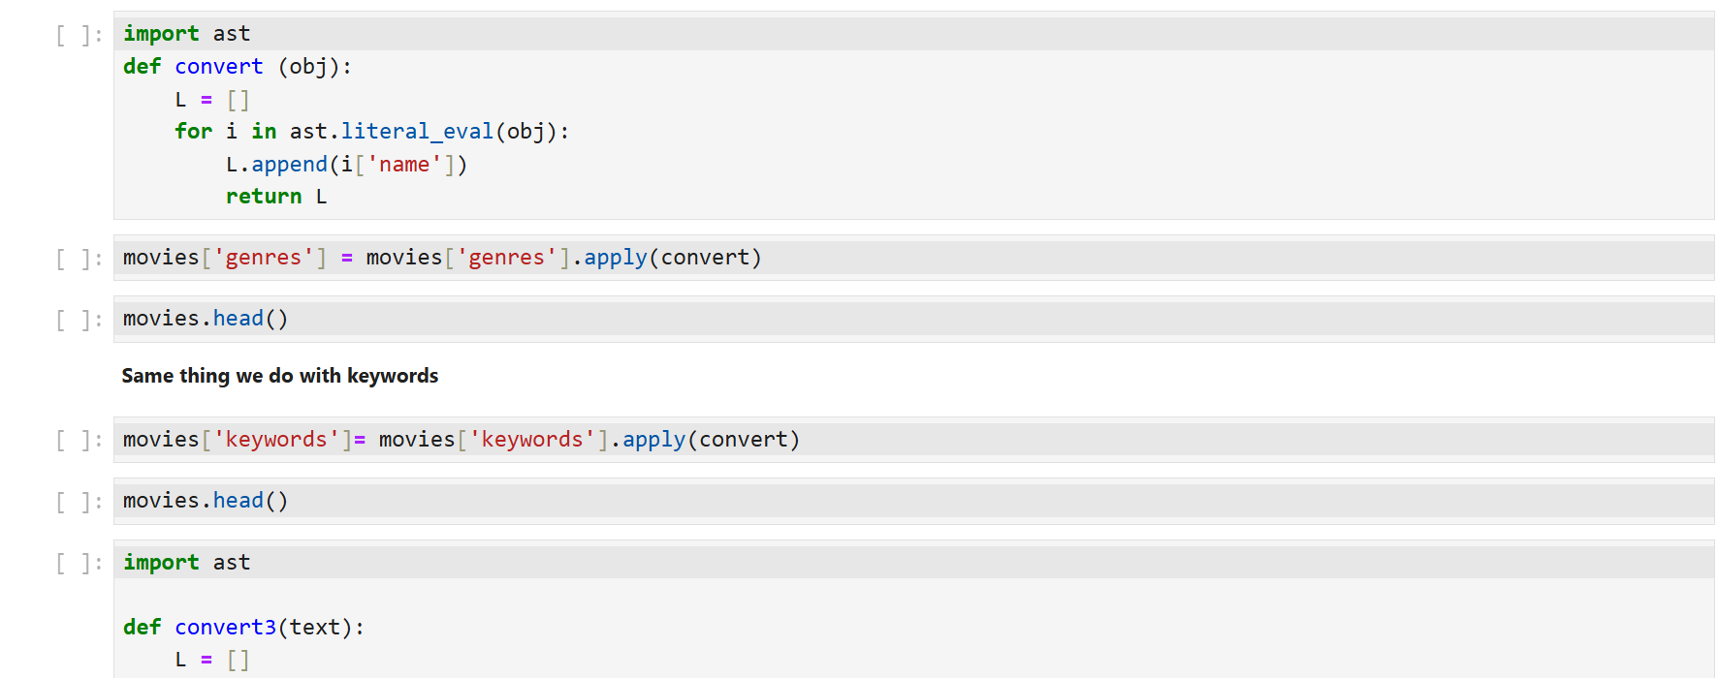
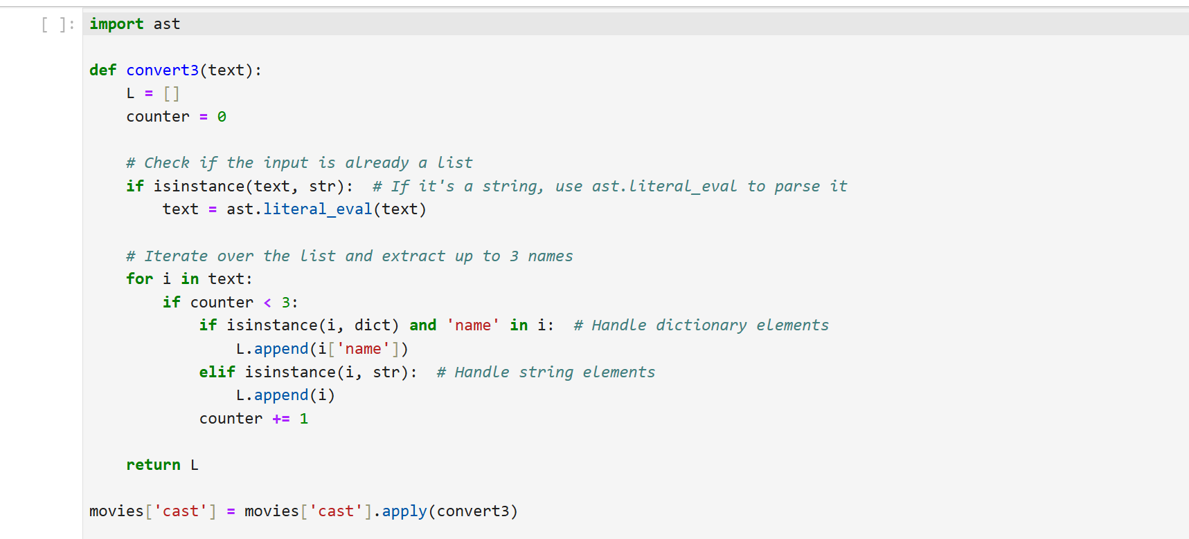

Slide 10
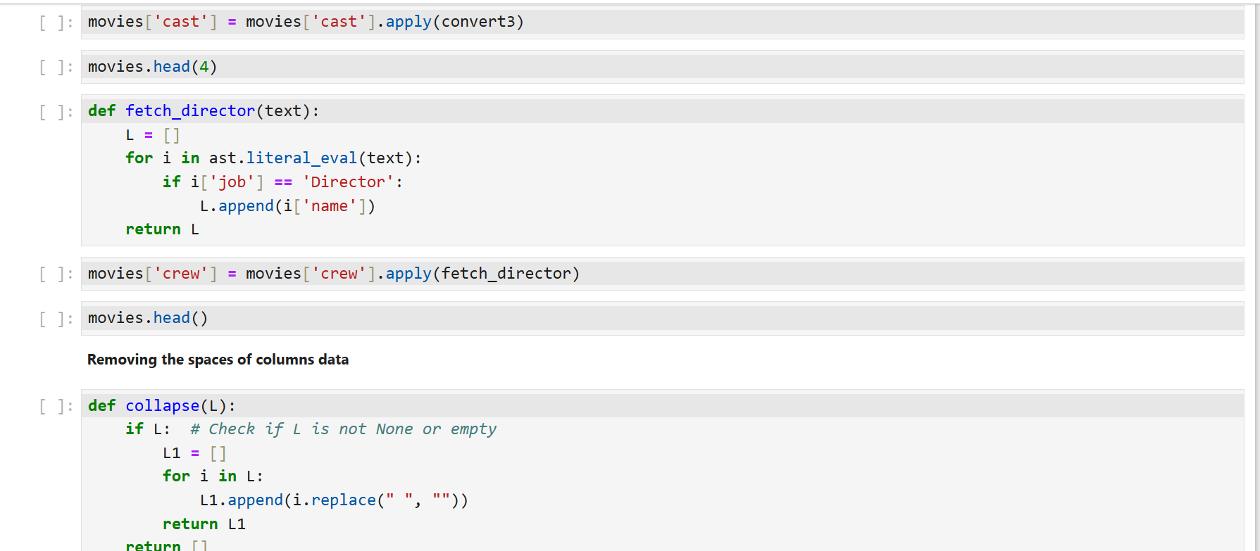
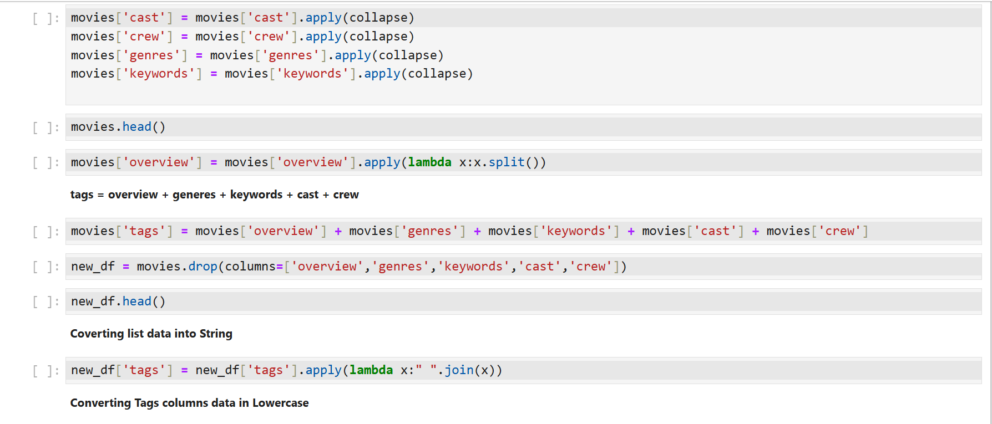

Slide 11
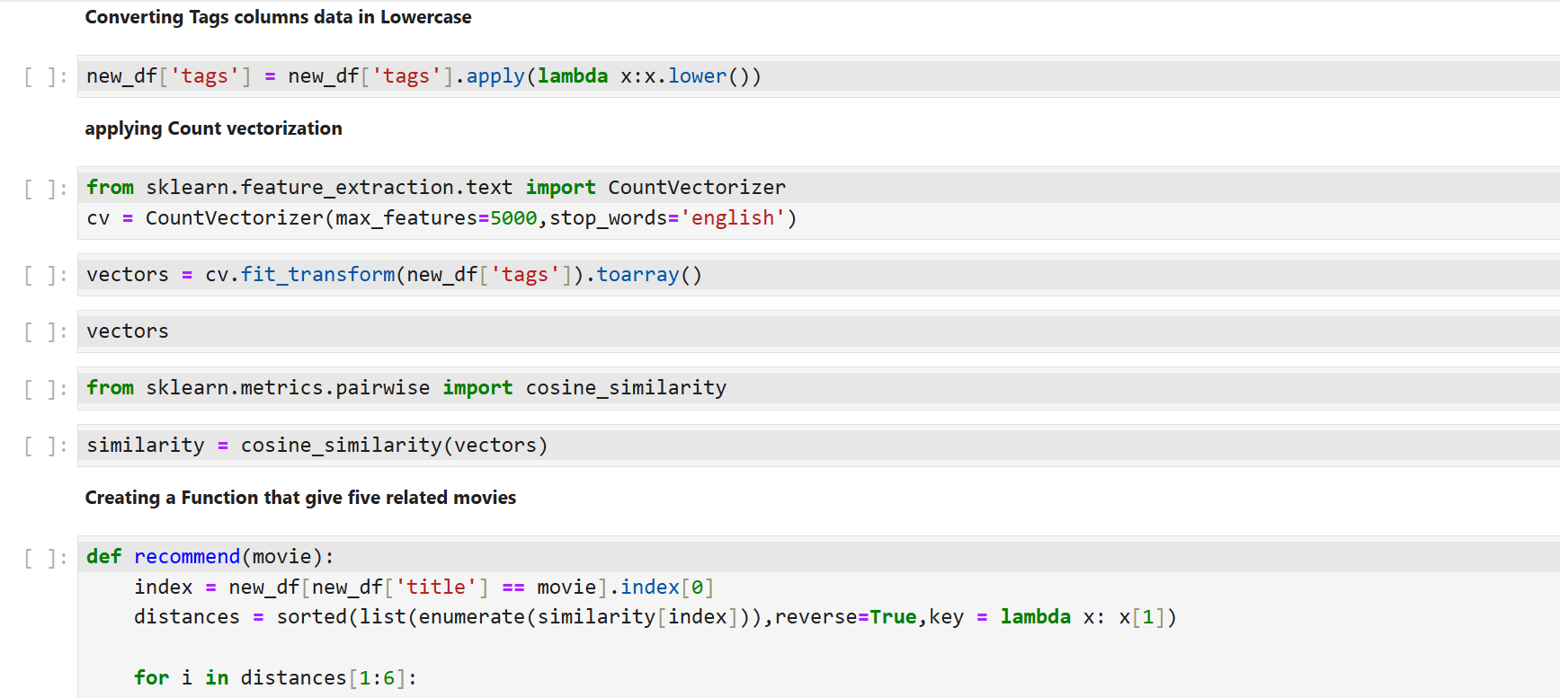
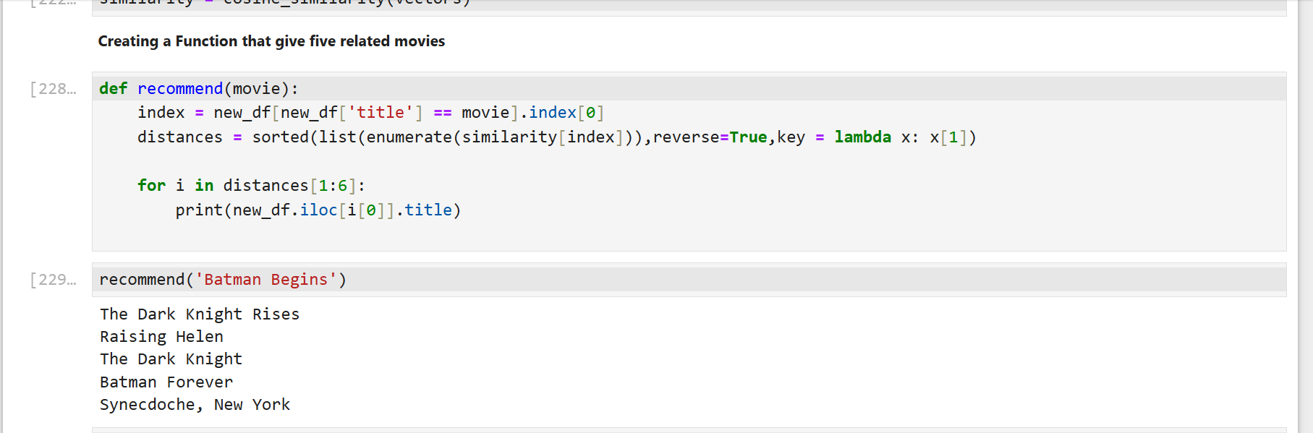

Slide 12
Web Application Development
Tool: Streamlit IDE: PyCharm
Web App Features:
User selects a movie from a dropdown.
Displays 5 recommended movies.
User-friendly interface.

Slide 13
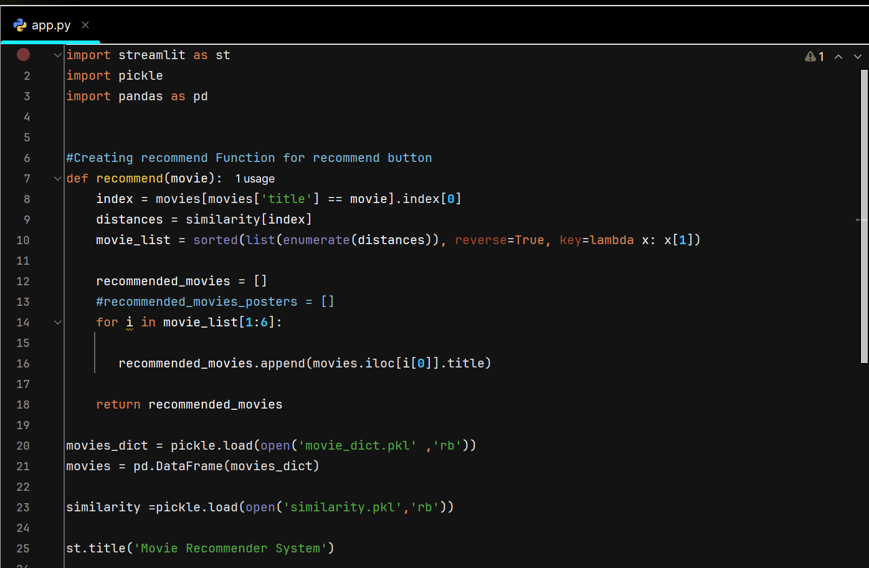
Streamlit Web Application Code

Slide 14
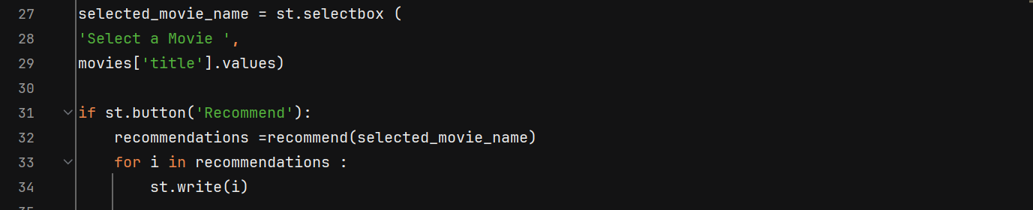
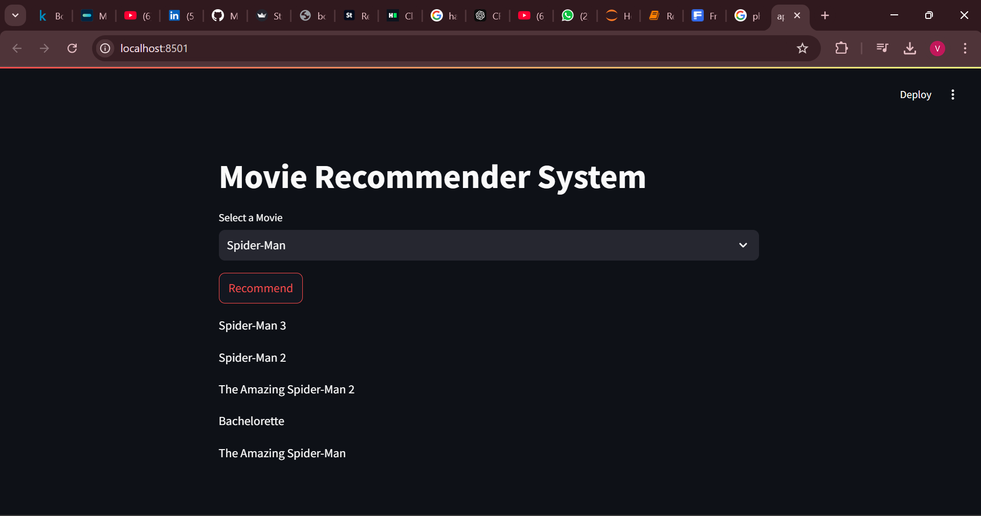
Application Demo
Five Recommended Movies

Slide 15
Conclusion
Successfully developed a Movie Recommender System.
Leveraged Python libraries for data processing and modeling.
Created an interactive web application using Streamlit.

